Slide 1

Team Seniors*
Julie Pierides, John Ho, Yi Li, Chloe Choi, Eun Bin Lee

Slide 2
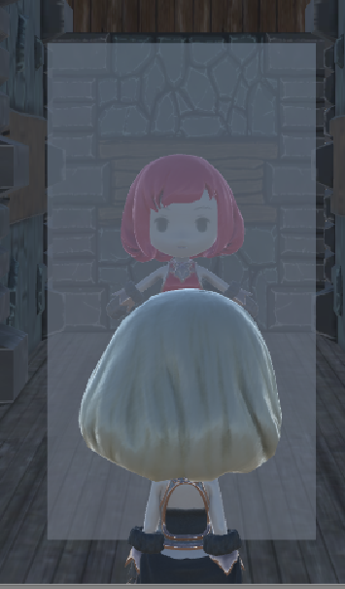
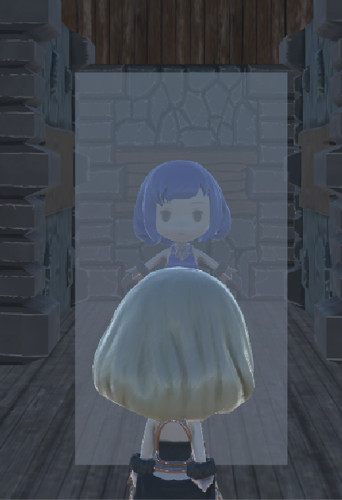
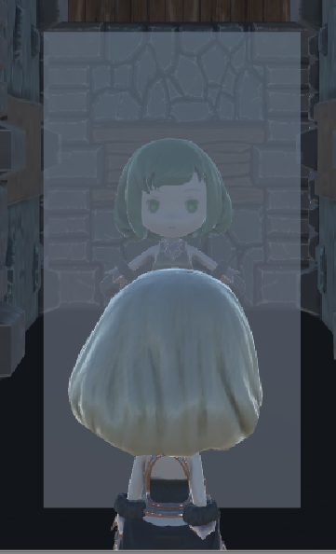
Story
Pirates stole your identity and now you don’t remember who you are. You can kill enemies to gain their respective color and transform into a different form. With the form you think is the correct one, you will have to find your captured identity.

Slide 3
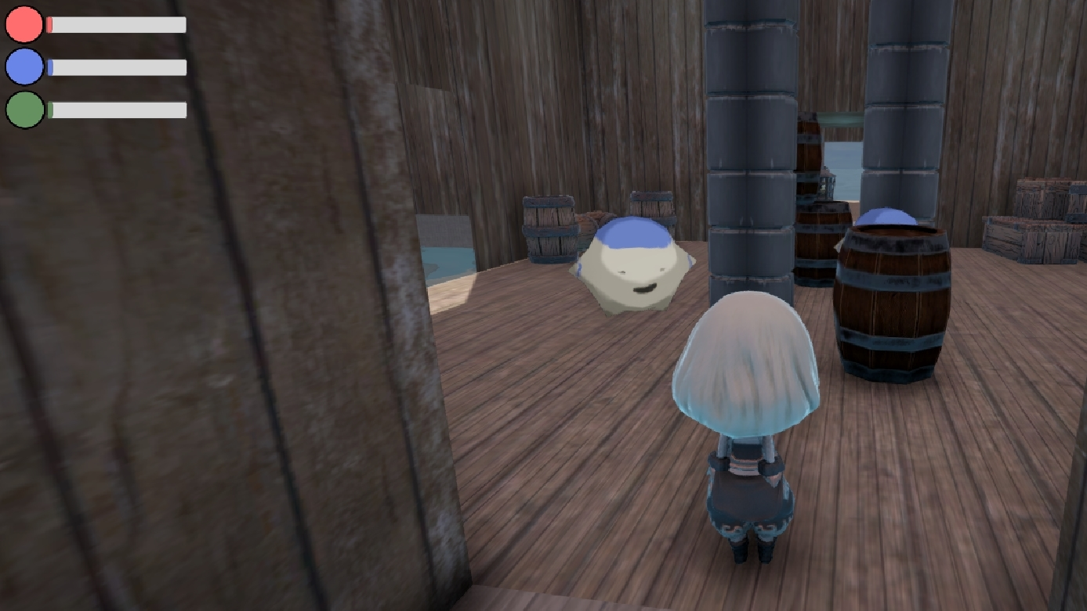
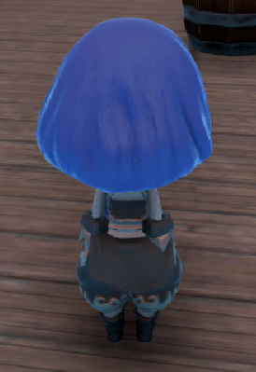
Interesting Mechanics
Defeating an enemy of a certain color adds that color to the player’s color bar. The player changes her color based on the bar that has the most points. Minibosses have no color but will drop memory hints to what your reflection color will be.

Slide 4
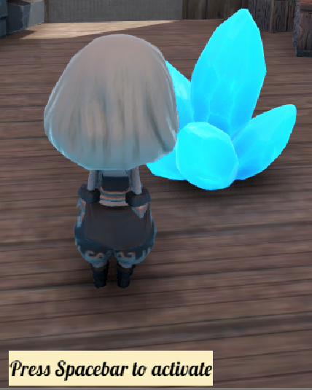
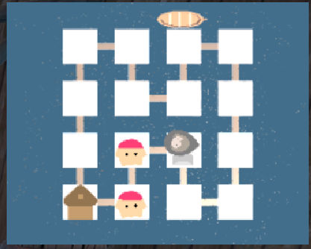
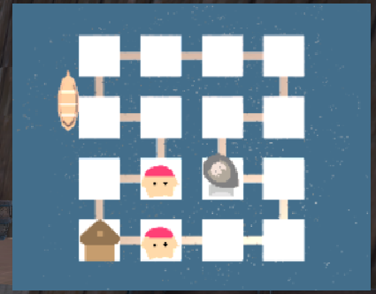
Interesting Mechanics
There is a switch in one of the rooms that allows the player to shift the position of the bridges that connect the rooms. This makes the player have to more carefully pay attention to the route that she wants to take in order to get to her goal.

Slide 5
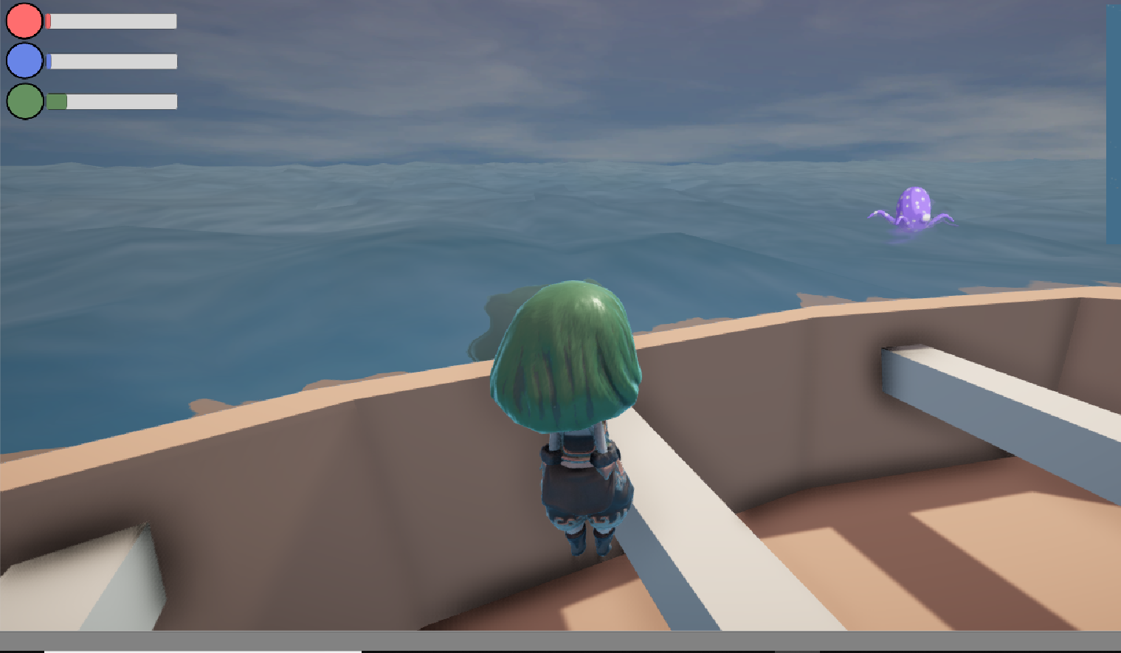
Interesting Mechanics
There is a boat that constantly loops around the map. The player can ride it as a sort of shortcut to get around the map but must think about the route that she wants to take first.

Slide 6
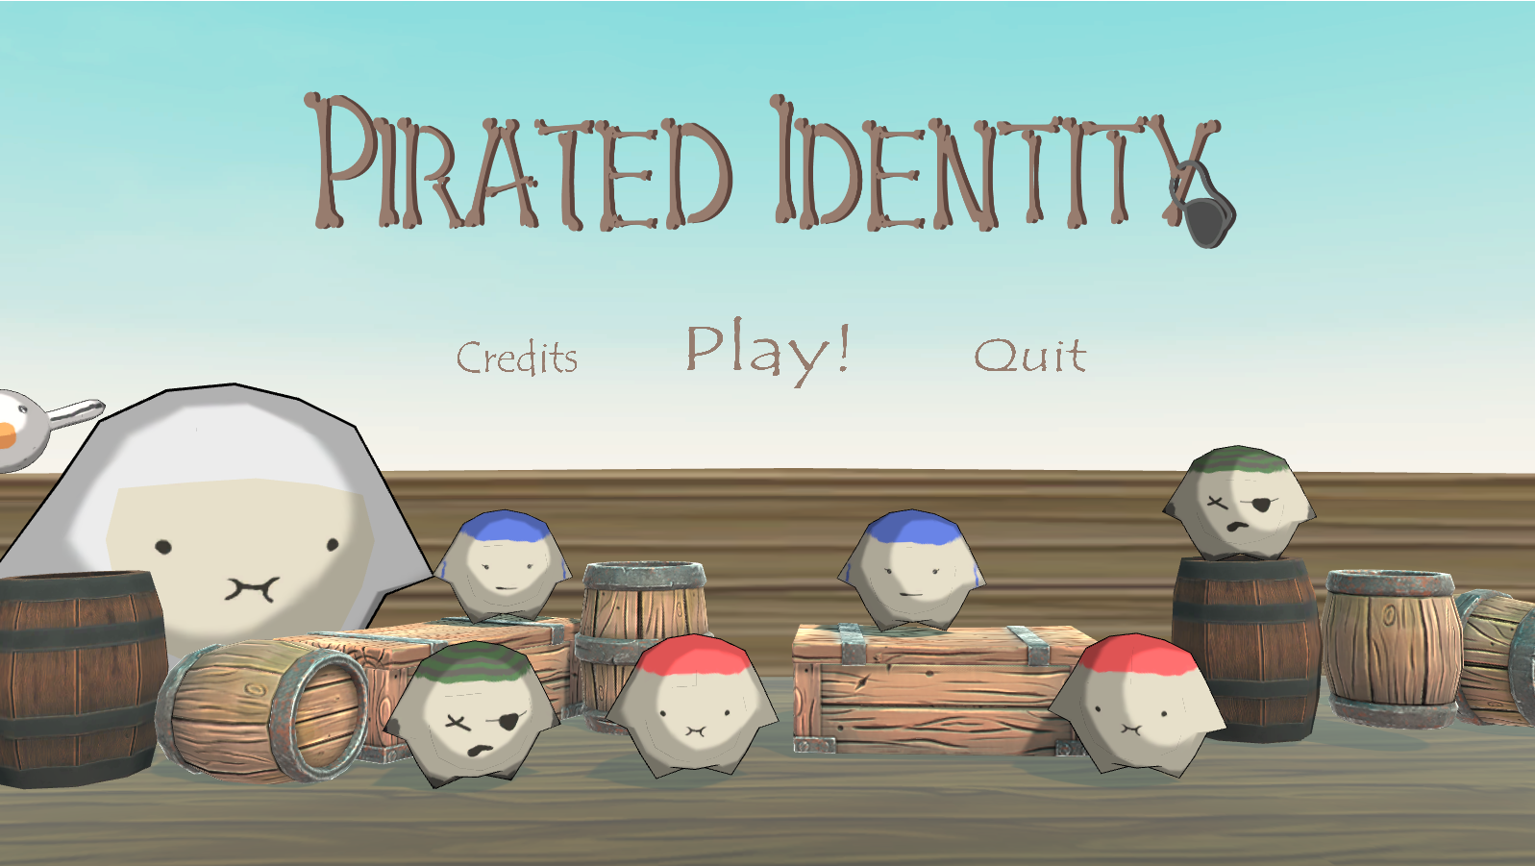
DEMO

